Slide 1
#SFDC #DF11
Screenshots from Salesforce.com Dreamforce 11 keynote presentation
2011-08-31 / @jukkan

Slide 2
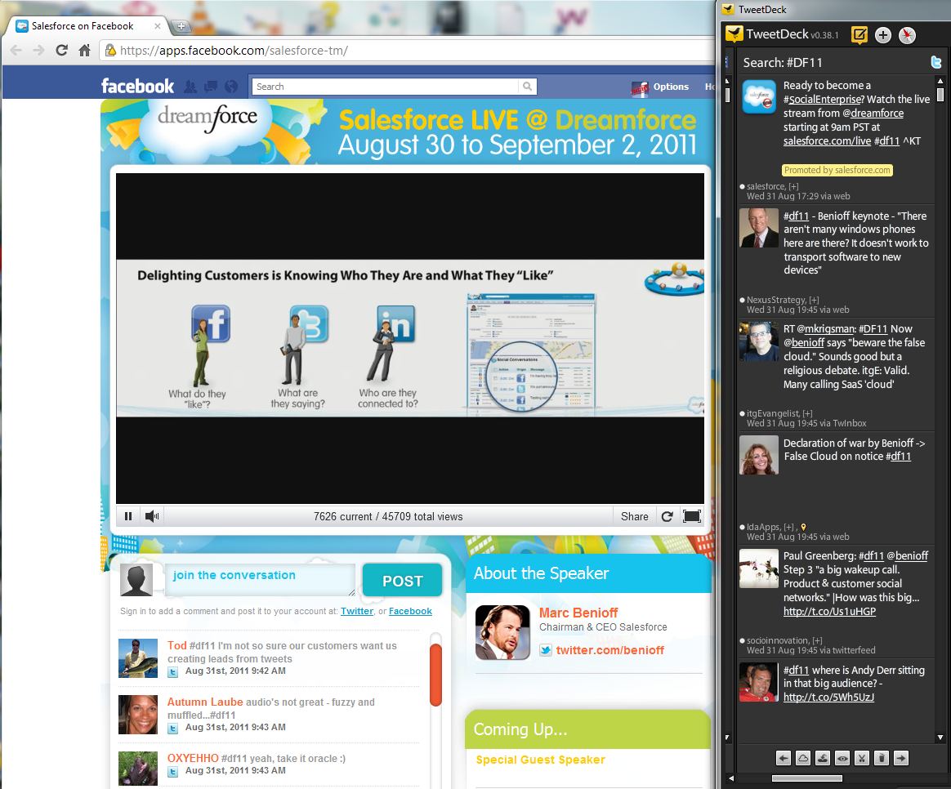
Live stream for #FB like’rs only

Slide 3
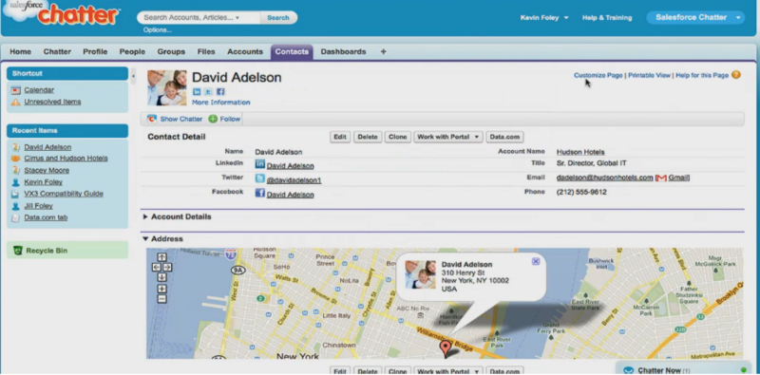
Social customer profile

Slide 4
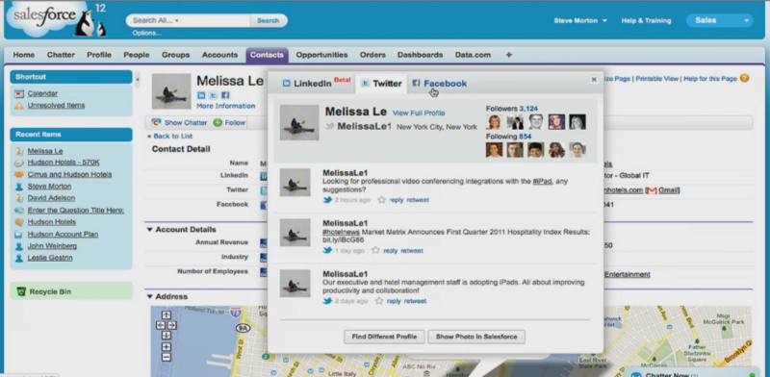
Public feeds on contacts

Slide 5
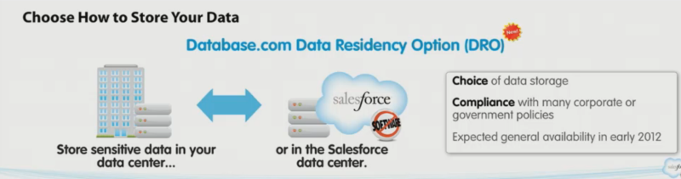
On-premises database support

Slide 6
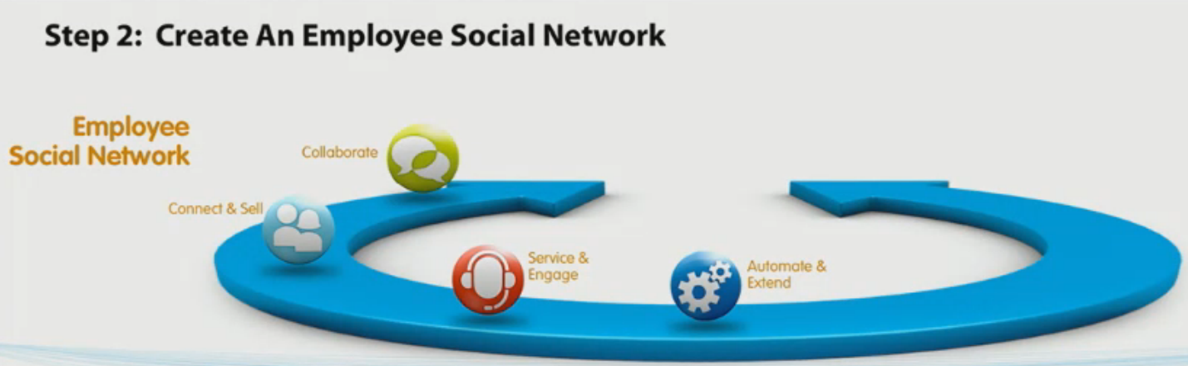
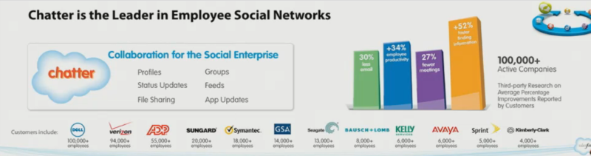
Chatter has become the new SFDC UI

Slide 7
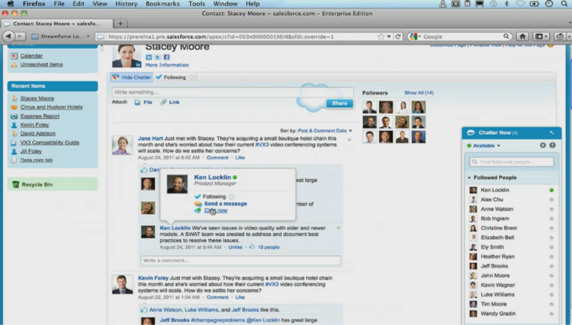
Chatter Now = Lync for SFDC

Slide 8
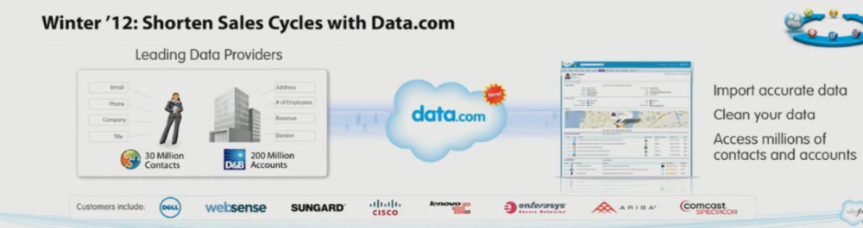
Jigsaw is now Data.com

Slide 9
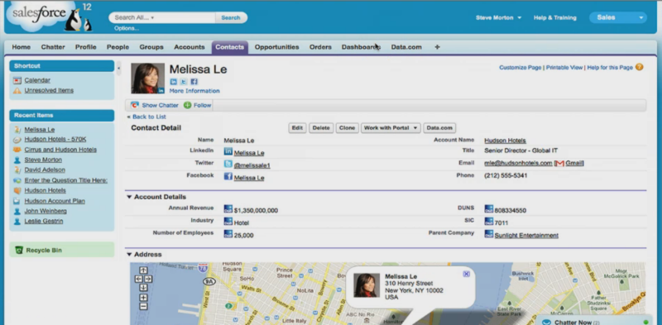
Data.com social profile enrichment

Slide 10
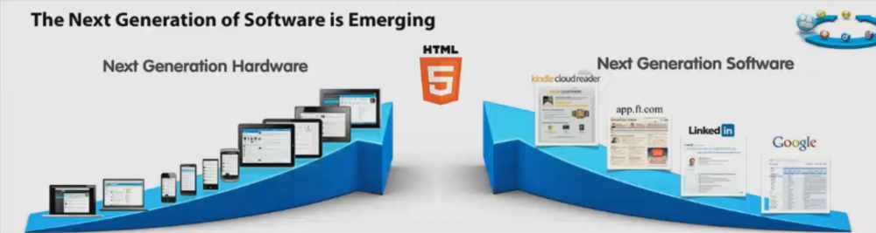
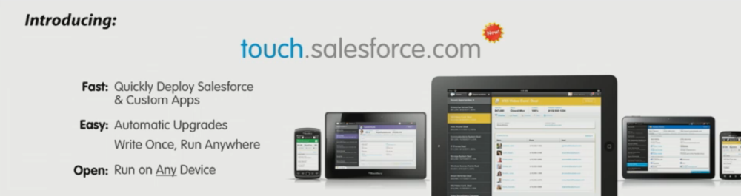
HTML5 for all touch enabled devices

Slide 11
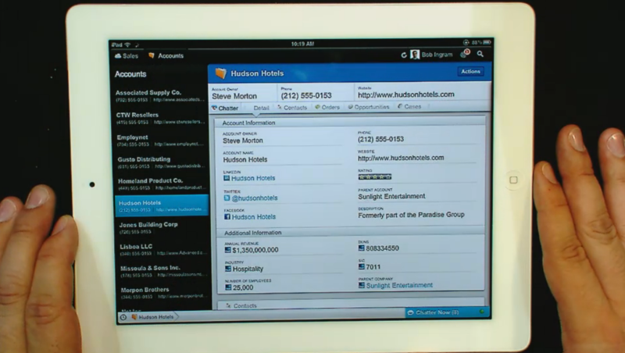
iPad: the be all, end all of SFDC

Slide 12
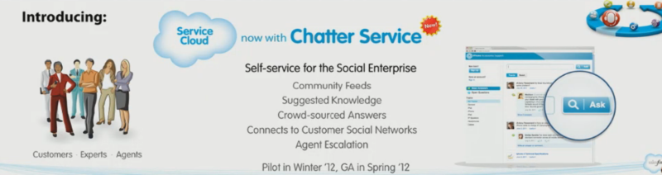
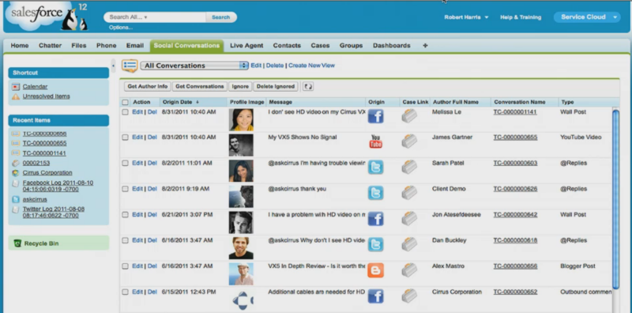
Customer service through Chatter

Slide 13
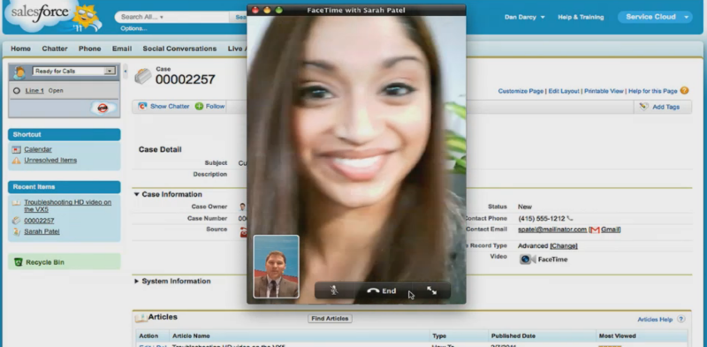
FaceTime

Slide 14
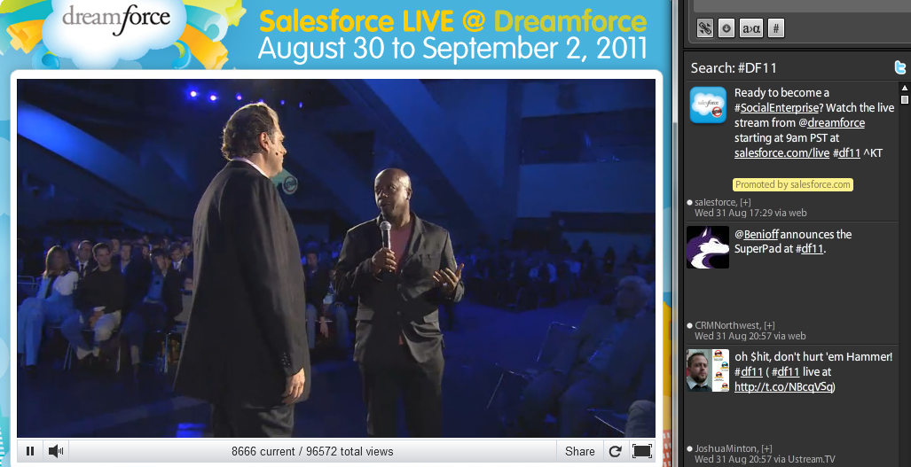
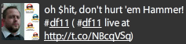
Hammer Time

